Slide 1
Lecture Design Goals
Lecturer: Haibin Wang

Slide 2
Topics:
Design Goals
Package Diagram
Component Diagram

Slide 3
Objectives:
Know what is system design.
Objectives
Understand some important terminologies of system design.
Be familiar with different design goals.

Slide 4
Analysis
Design
Implementation
System Design
Design Goal
System Decomposition
Classic Architectures
Distributed Architectures
Object Design
Design Principles1
Design Principles2
From Design
To Implementation
Design Patterns1
Design Patterns2
Design Patterns3
Design Patterns4
Object Design
Database Design
GUI Design
Infrastructure Design
Database Design
GUI
Design
Infrastructure Design
WHERE ARE WE?

Slide 5
Why is Design so Difficult?
Analysis: Focuses on the application domain
Design: Focuses on the solution domain
The solution domain is changing very rapidly
Halftime knowledge in software engineering: About 3-5 years
Cost of hardware rapidly sinking
Design knowledge is a moving target
1. Introduction
Notes:
What I teach today will be out of date in 3 years

Slide 6
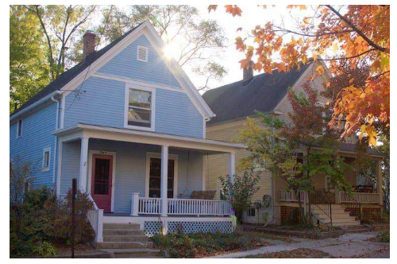
Design Example
Designing a residential house
Functional requirements:
This house should have two bedrooms, a study, a kitchen, and a living room area.
Nonfunctional requirements:
The overall distance the occupants walk every day should be minimized.
The use of daylight should be maximized.
1. Introduction

Slide 7
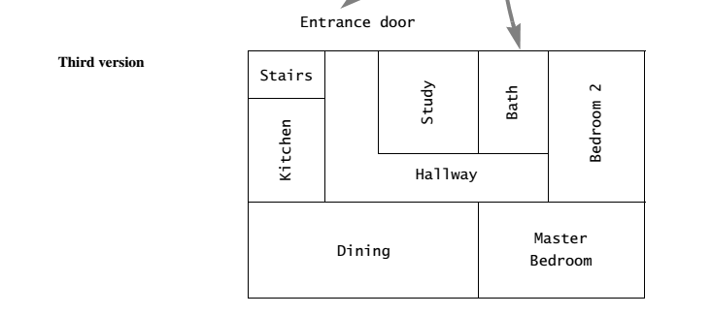
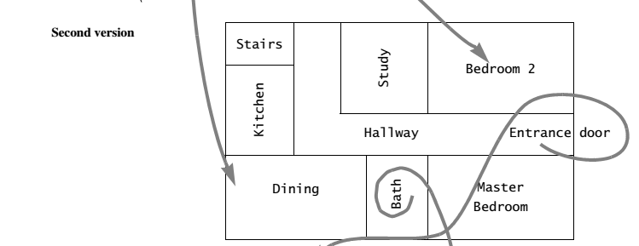
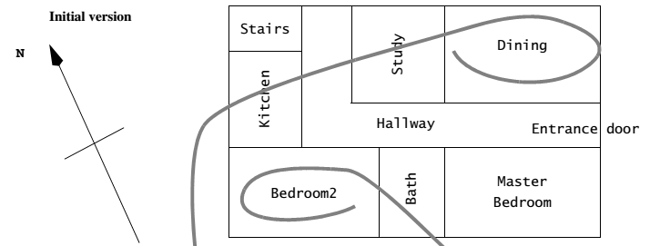
Design of The House
Design Example
1. Introduction

Slide 8
Design Example
1. Introduction

Slide 9
Design Types
Object Design
B
System Design
A
C
GUI Design
Concept
Infrastructure Design
E
D
Database Design
1. Introduction

Slide 10
Bridge the gap
Between a problem and an existing system in a manageable way
Problem
How?
Use Divide & Conquer:
1) Identify design goals
2) Model the new system design as a set of subsystems
3) Address the major design goals.
System
Design
System
1. Introduction

Slide 11
What do we already have?
Analysis results:
A set of nonfunctional requirements and constraints, such as maximum response time, minimum throughput, reliability, operating system platform, and so on
A functional model, describing the system functionality from the actors’ point of view
An structural model, describing the entities manipulated by the system
Behavioral models for each use case, showing the sequence of interactions among objects participating in the use case.
1. Introduction

Slide 12
What will we have?
System design results:
Design goals, describing the qualities of the system that developers should optimize
Software architecture, describing the subsystem decomposition in terms of subsystem responsibilities, dependencies among subsystems, subsystem mapping to hardware, and major policy decisions such as control flow, access control, and data storage
Boundary use cases, describing the system configuration, startup, shutdown, and exception handling issues.
1. Introduction

Slide 13
Where can we get design goals?
Nonfunctional Requirements!
2. Design Goals

Slide 14
Design Criteria
Performance
Dependability
Cost
Design criteria
End User
Maintenance
2. Design Goals

Slide 15
Performance Criteria
How soon is a user request acknowledged after the request has been issued?
Performance
How much space is required for the system to run?
Memory
Cost
Response
Time
Throughput
How many tasks can the system accomplish in a fixed period of time?
2. Design Goals

Slide 16
Dependability Criteria
Security
Ability to withstand malicious attacks
Ability to survive invalid user input
Dependability
Robustness
Safety
Ability to avoid endangering human lives, even in the presence of errors and
failures
Reliability
Fault
tolerance
Ability to operate under erroneous conditions
Availability
Difference between specified and observed behavior
Percentage of time that system can be used to accomplish normal tasks
2. Design Goals

Slide 17
Cost Criteria
Cost of developing the initial system
Administration
cost
Cost required to administer the system
Cost
Development
cost
Maintenance
cost
Cost required for bug fixes and enhancements to the system
Deployment
cost
Upgrade
cost
Cost of translating data from the previous system. This criteria results in backward compatibility requirements
Cost of installing the system and training the users
2. Design Goals

Slide 18
Maintenance Criteria
How easy is it to add functionality or new classes to the system?
Traceability
How easy is it to map the code to specific requirements?
Maintenance
Extensibility
Readability
How easy is it to understand the system from reading the code?
Modifiability
Portability
How easy is it to port the system to different platforms?
Adaptability
How easy is it to change the functionality of the system?
How easy is it to port the system to different application domains?
2. Design Goals

Slide 19
End User Criteria
Usability
End User
How easy is it for the user to use the system?
How well does the system support the work of the user?
Utility
2. Design Goals

Slide 20
Stakeholders have different Design Goals
Low cost
Increased productivity
Backward compatibility
Traceability of requirements
Rapid development
Flexibility
Functionality
User-friendliness
Usability
Ease of learning
Fault tolerant
Robustness
Runtime
Efficiency
Minimum # of errors
Modifiability, Readability
Reusability, Adaptability
Well-defined interfaces
Reliability
Portability
Good documentation
Client
(Customer)
End User
Developer/Maintainer
2. Design Goals

Slide 21
Typical Design Trade-offs
Functionality
Usability
Cost
Robustness
Efficiency
Portability
Rapid development
Functionality
Backward Compatibility
Reusability
Cost
Readability
2. Design Goals
Notes:
Example: Functionality vs usability. Is a system with 100 functions usable? How about a large scale menu?
Low Cost vs Robustness: A low cost system does not check for errors when the user is entering wrong data
(ebay Entry 5.00 vs 5,00). Let‘s say you bid for 5, 00 Euro
In Germany 5,00 is 5 Euros, if the entry routine expects a „.“, then the „,“ might be overlooked,
and you have bidden. for 500 Dollars!
Efficiency vs Portability: Can you build a portable real-time game? How do you get high framerates. Special graphics routines that access the display buffer! That is usually not portable. If you write portable graphics code, say with the OpenGL, then you sometimes might not get the response times you are looking for. All special graphics code is still hand-tailored for a specific machine or graphics processor.
Rapid development vs. functionality: Let’s say your development time is 5 weeks, you have 5 programmers, your design window is 2 weeks, after design 3 programmers are leaving your company, and your delivery deadline cannot be moved. You are going to reduce the functionality. Not all the use cases in your model can be implemented nor delivered.
Cost vs. Reusability: This is an interesting trade-off, whose validity is changing right now. In the past, if you tried to make your design reusable you had to add extra effort. Recode your data structures (move from array of int to array of Generic). Moving from a 1-1 association to a many-many association involved more coding and more testing. Nowadays, with design patterns, this trade-off is changing a little bit. You can get reusability pretty cheap if you use design patterns!
Backward Compatibility vs Readability.
The same applies to this trade-off. In the past you would guarantee backward compatibility by introducing special switches.
#Ifdef OldSystem then WriteToPaperTapeWriter
#Ifdef Newsystems then WritetoCD-R
Nowadays, again with the use of design patterns, for example, the bridge pattern, you can keep a system backward compatibile and still keep it readable!

Slide 22
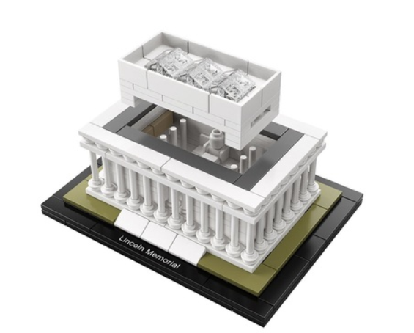
Package Diagram
How to specify system architecture?
Package Diagram(Logical)
Component Diagram(Physical)
3. PACKAGE DIAGRAM

Slide 23
Package Diagram - Definition
Package diagram, a kind of structural diagram, shows the arrangement and organization of model elements in middle to large scale project.
Package diagram can show both structure and dependencies between sub-systems or modules, showing different views of a system.
3. PACKAGE DIAGRAM

Slide 24
Package Diagram - Purpose
Package diagrams are used to structure high level system elements. Packages are used for organizing large system which contains diagrams, documents and other key deliverables.
Package Diagram can be used to simplify complex class diagrams, it can group classes into packages.
A package is a collection of logically related UML elements.
Packages are depicted as file folders and can be used on any of the UML diagrams.
3. PACKAGE DIAGRAM

Slide 25
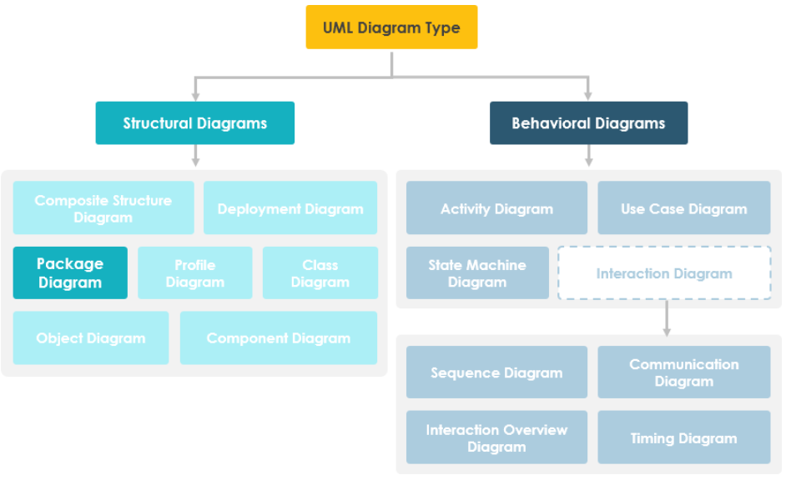
Package Diagram - Position
3. PACKAGE DIAGRAM

Slide 26
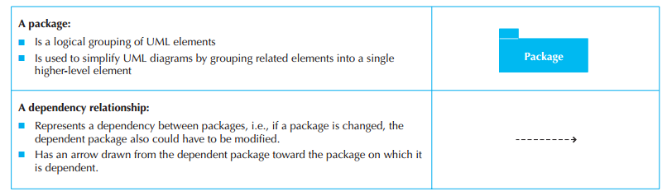
Package Diagram - Syntax
3. PACKAGE DIAGRAM

Slide 27
Package Diagram - Package
The package is the UML mechanism for grouping items.
Constraints
Package name should not be the same for a system.
Packages can include whole diagrams, name of components alone or no components at all.
Each package has its own namespace within which all names must be unique.
Every model element is owned by one package.
The packages form a hierarchy.
The set of UML building blocks consists of things, relationships, and diagrams.
3. PACKAGE DIAGRAM

Slide 28
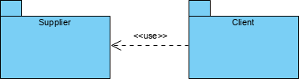

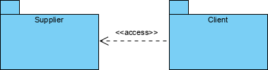
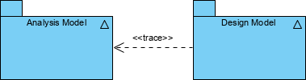
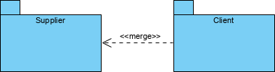
Package Diagram - Dependency
<<use>> - An element uses a public element in the supplier package in some way
<<import>> - one package imports the functionality of other package
<<access>> - one package requires help from functions of other package.
3. PACKAGE DIAGRAM

Slide 29
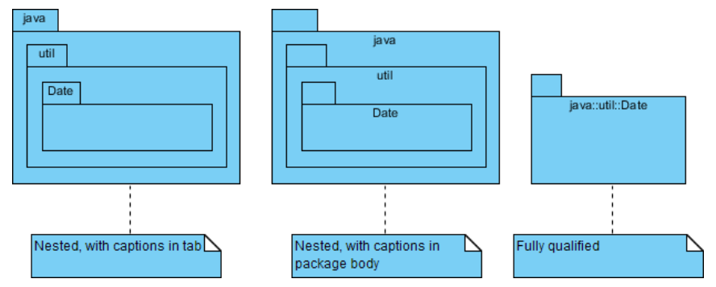
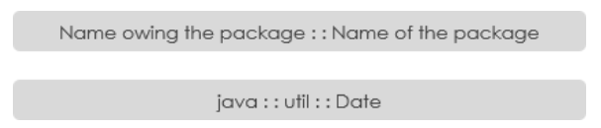
Package Diagram - Syntax
Constraints
Package name should not be the same for a system, however classes inside different packages could have the same name.
Packages can include whole diagrams, name of components alone or no components at all.
Fully qualified name of a package has the following syntax.
3. PACKAGE DIAGRAM

Slide 30
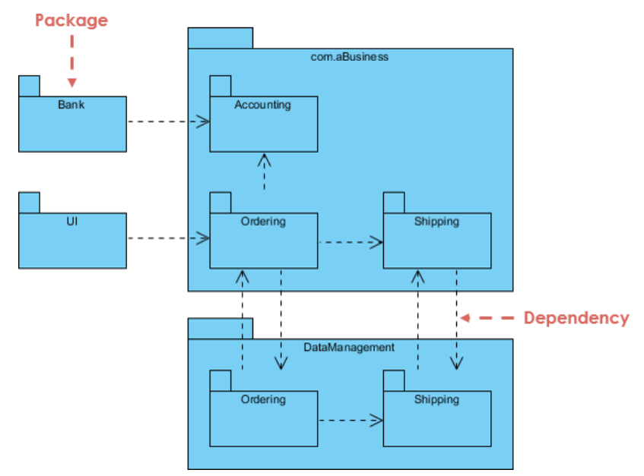
Package Diagram – At a glance
3. PACKAGE DIAGRAM

Slide 31
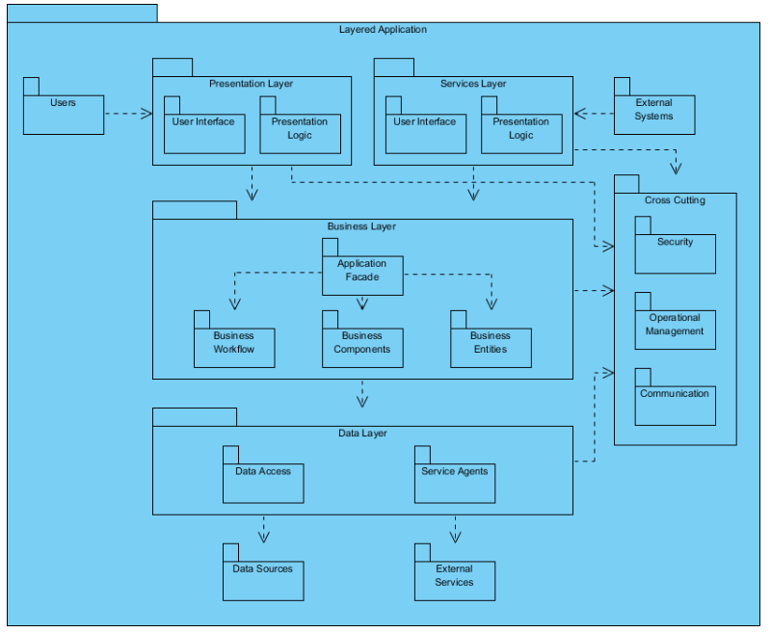
Package Diagram - Modeling Complex Grouping
3. PACKAGE DIAGRAM

Slide 32
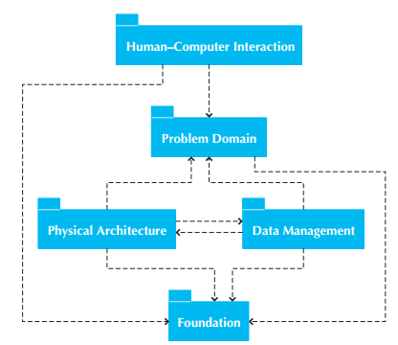
Package Diagram – Example1
3. PACKAGE DIAGRAM

Slide 33
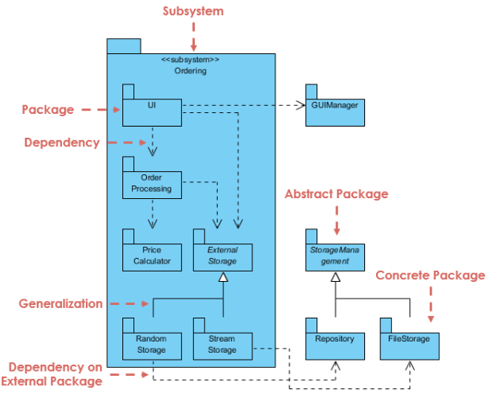
Package Diagram – Example2
3. PACKAGE DIAGRAM

Slide 34
Package Diagram – Steps
Set the context.
Cluster classes together based on shared relationships.
Model clustered classes as a package.
Identify dependency relationships among packages.
Place dependency relationships between packages.
3. PACKAGE DIAGRAM

Slide 35

Package Diagram – Your turn
Order Processing System - The Problem Description
Track Order module is responsible for providing tracking information through UI framework for the products ordered by customers. Customer types in the tracking serial number, Track Order modules refers the system and updates the current shipping status to the customer.
Track order should get order details from Order Processing which has to know the tracking info given by the customer. To know shipping information, Shipping can import Track Order to make the navigation easier. Track Order dependency to UI Framework is also mapped which completes our Package Diagram for Order Processing subsystem.
3. PACKAGE DIAGRAM

Slide 36

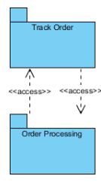
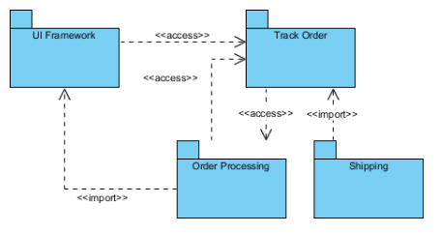
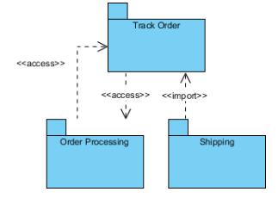
Package Diagram – Solution
Identify the packages of the system
Identify the dependencies in the System
3. PACKAGE DIAGRAM

Slide 37
Component Diagram - Definition
UML Component diagrams are used in modeling the physical aspects of object-oriented systems that are used for visualizing, specifying, and documenting component-based systems and also for constructing executable systems through forward and reverse engineering.
Component diagrams are essentially class diagrams that focus on a system's components that often used to model the static implementation view of a system.
4. COMPONENT DIAGRAM

Slide 38
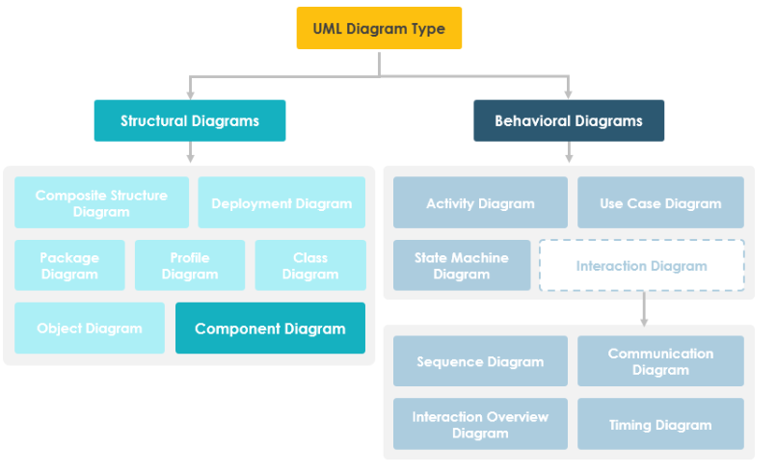
Component Diagram - Position
4. COMPONENT DIAGRAM

Slide 39

Component Diagram - Component
A component represents a modular part of a system that encapsulates its contents and whose manifestation is replaceable within its environment.
A component is drawn as a rectangle with optional compartments stacked vertically.
A rectangle with the component's name
A rectangle with the component icon
A rectangle with the stereotype text and/or icon
4. COMPONENT DIAGRAM

Slide 40
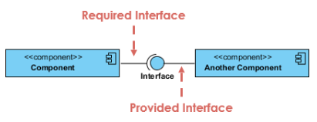
Component Diagram - Interface
two type of component interfaces:
Provided interface symbols with a complete circle at their end represent an interface that the component provides - this "lollipop" symbol is shorthand for a realization relationship of an interface classifier.
Required Interface symbols with only a half circle at their end (a.k.a. sockets) represent an interface that the component requires (in both cases, the interface's name is placed near the interface symbol itself).
4. COMPONENT DIAGRAM

Slide 41
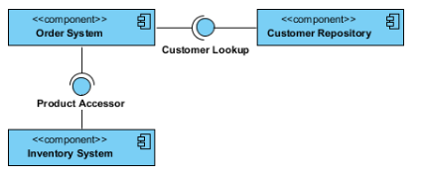
Component Diagram– Interface Example（Order system）
4. COMPONENT DIAGRAM

Slide 42
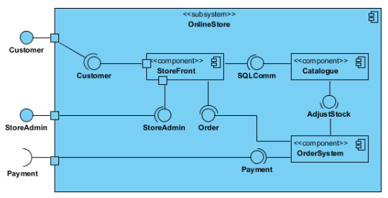
Component Diagram - Subsystems
The subsystem classifier is a specialized version of a component classifier.
4. COMPONENT DIAGRAM

Slide 43
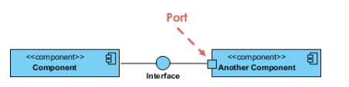
Component Diagram - Port
Ports are represented using a square along the edge of the system or a component.
A port is often used to help expose required and provided interfaces of a component.
4. COMPONENT DIAGRAM

Slide 44






Component Diagram - Relationships
A component diagram is a collection of vertices and arcs and commonly contain components, interfaces and relationships such as：
dependency
aggregation
composition
constraint
generalization
association
4. COMPONENT DIAGRAM

Slide 45
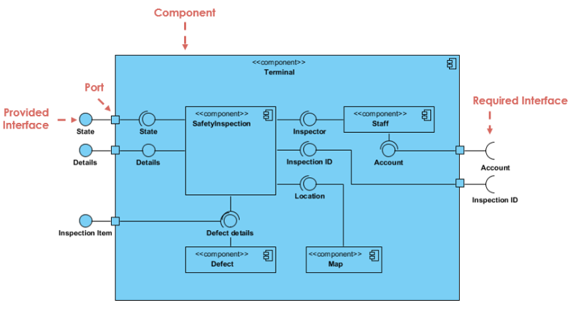
Component Diagram– At a glance
4. COMPONENT DIAGRAM

Slide 46
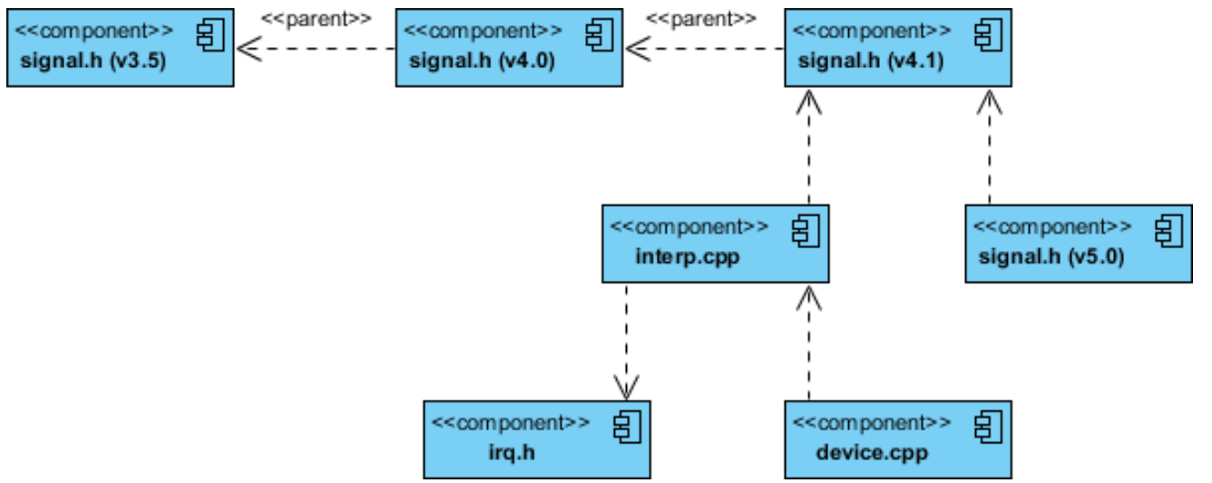
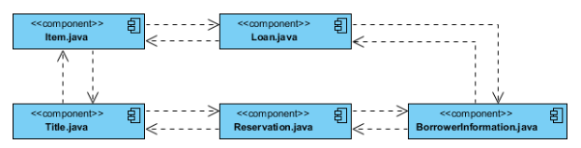
Component Diagram– Modeling Source Code
4. COMPONENT DIAGRAM

Slide 47
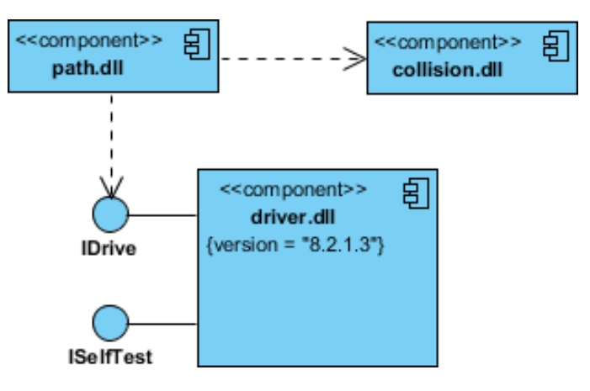
Component Diagram– Modeling an Executable Release
4. COMPONENT DIAGRAM

Slide 48
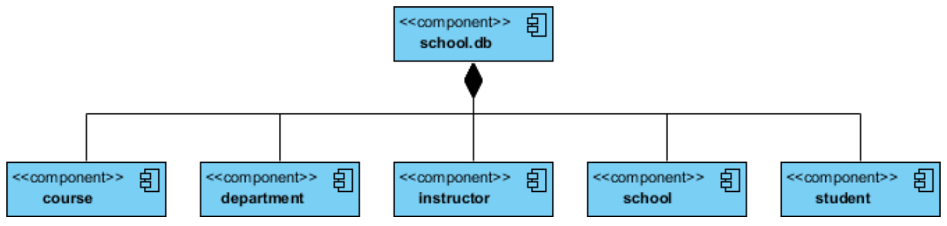
Component Diagram– Modeling a Physical Database
4. COMPONENT DIAGRAM

Slide 49
Thank You !

